Slide 1
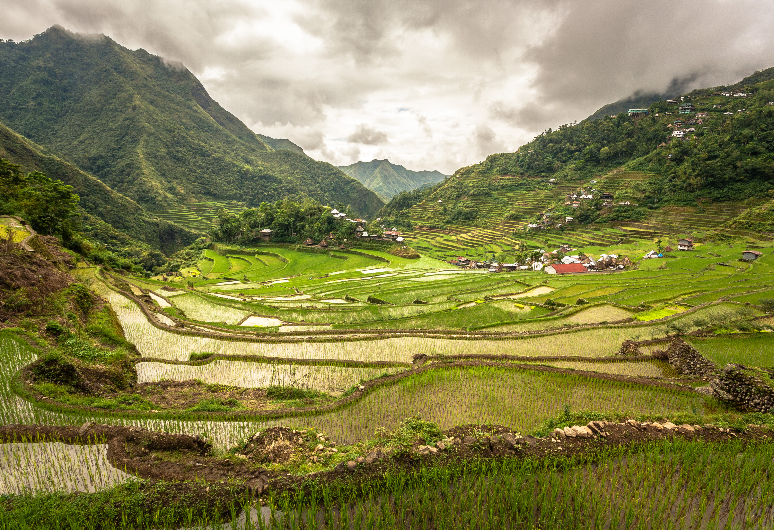
What is Landscape Archaeology? And What are its Advantages and Importance?

Slide 2
An New Aspect of Archaeology - Different Focus
Not only literature and objects can be used as sources, but also the cultural landscape.
Which is an area (either natural or unnatural) associated with historic events, human activities, or social change.

Slide 3
Four examples (in brief)
1. The Seusamora (name of a city) in Eastern Georgia.
The settlement development and decline across different time periods at Seusamora.
2. A study on fishing in UK.
Swims (fishing places). – names / locations of the swims.
Various knowledge and customs of fishing, such as choosing baits or swims.

Slide 4
3. The change analysis of the green spaces of the Historical Peninsula in Istanbul, Turkey.
The area has been subject to planning legislation several times.
Establish the location of green spaces.
Examined functional and spatial changes of green.
The alteration of those spaces due to changing social structures, political decisions, planning legislation and physical conditions.
Maps and Literary material on social change.

Slide 5
4. Irrigation and landscape: An interdisciplinary approach. - Irrigation in the Zerqa triangle in the Jordan Valley.
The settlement patterns.
The canal system.
“Physical aspects of the irrigated landscape will be explored by basic hydrological and hydraulic modelling.”

Slide 6
References
Aktas, Nilüfer K. Landscape Archaeology between Art and Science: From a Multi- to an Interdisciplinary Approach. Edited by Kluiving, Sjoerd, and Erika Guttmann-Bond. LHS: Amsterdam University Press, 2012.
Birnbaum, Charles A. “Protecting Cultural Landscapes: Planning, Treatment and Management of Historic Landscapes.” Preservation briefs, no. 36, 1994, pp. 1-20.
Bradley, Richard. An Archaeology of Natural Places. Routledge, 2000.
Demetradze, Irina, and Guram Kipiani. Landscape Archaeology between Art and Science: From a Multi- to an Interdisciplinary Approach. Edited by Kluiving, Sjoerd, and Erika Guttmann-Bond. LHS: Amsterdam University Press, 2012.
Ertsen, Maurits. Landscape Archaeology between Art and Science: From a Multi- to an Interdisciplinary Approach. Edited by Kluiving, Sjoerd, and Erika Guttmann-Bond. LHS: Amsterdam University Press, 2012.
Tilley, Christopher, and Kate Cameron-Daum. An Anthropology of Landscape. UCL Press, 2017.

